Slide 1

Computational Intelligence for Optimization
Final Project
Alex Anthony Panchot (M20190546)
Bruno de Lima Vieira (M20190922)
Hugo Saisse Mentzingen da Silva (M20190215)
Leonardo Motta Perazzo Lannes (M20180036)

Slide 2
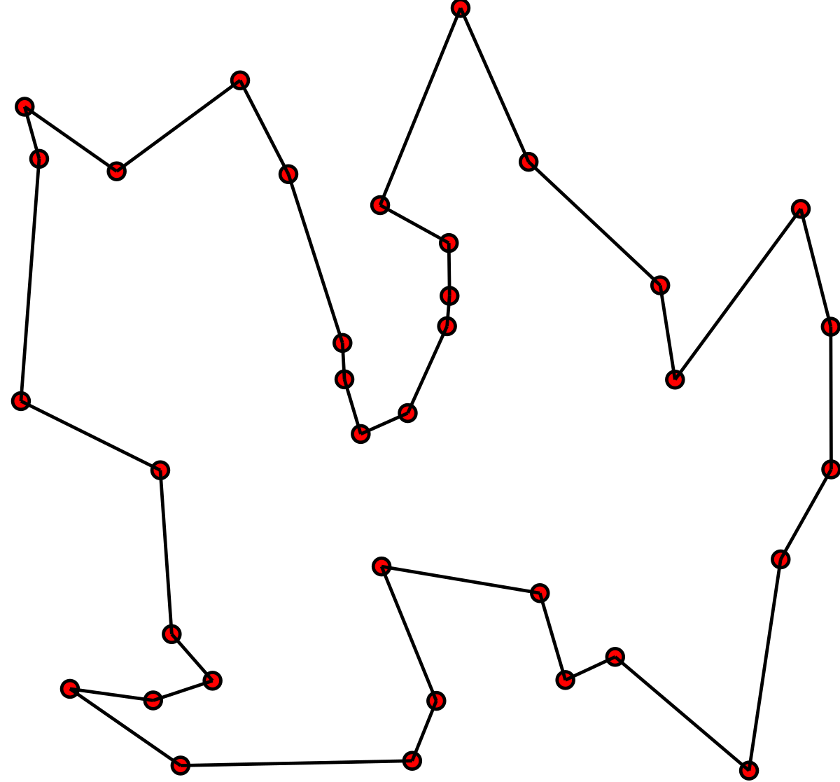
Travel Salesman Problem (TSP)

Slide 3
Encoding
We will be using the most natural and commonly used way to represent the TSP problem: the i-th element of the representation denotes the i-th destination visited.
For instance, suppose that the following distance matrix has been provided:
Matrix = [[0, 15, 3, 4],
[15, 0, 8, 7],
[3, 8, 0, 12],
[4, 7, 12, 0]]
This example shows us the distances between 4 cities. The first city will be represented by “0”, the second one by “1”, and so on. Thus, the last city will be called “n-1”.
Moreover, the encoding is defined by an n-size list in Python, in which the tour City 2 → City 4 → City 3 → City 1 is given by [1,3,2,0].

Slide 4
Initializations
We have implemented 3 different sorts of initialization:
Randomly: this kind of initialization only generates a permutation from [0,1,2,3,…,n-2, n-1], e.g, [1,0,2,3,…,n-2, n-1]. Since we have been using a population with 20 members, the initial population is given by 20 permutations randomly generated.
Using Hill Climbing: the first stage of this method is to generate a population randomly as with the previous one. The main difference is that the first generation will be the outcome which has been optimized by the hill-climbing algorithm.

Slide 5
N-Queens Initialization
N-Queens: This initialization method works by the same principle as the N-Queen problem.
The departure city is imagined as the row of a matrix and the arrival city as the column of the matrix.
The algorithm then “places” a “queen” on a selected row and column and blocks out all other points in that particular row and column such that there cannot be two “queens” on the same row or column.
Then the algorithm moves to the row of the chosen city and selects the lowest available city
In order to pick different combinations for an initial population, the algorithm will sometimes select the second best city in order to leave the best city available for selection later.
Notes:
The algorithm always starts in the first city and selects the second by choosing an available city with the lowest distance.

Slide 6
Mutations and Crossovers
Swap mutation
Insert mutation
Scramble mutation
Inversion mutation
Partially Mapped Crossover (PMX)
Order Crossover
Cycle Crossover
Edge Crossover

Slide 7
Edge Crossover
Pick two parents at random
Construct the edge table: this table contains, for each element, all the other elements that are linked to it in the two parents. A ‘+’ in the table indicates that the edge is present in both parents (edges that have a ‘+’ are called ‘common edges’).
Parent 1:
Parent 2:
1 | 2 | 3 | 4 | 5 | 6 | 7 | 8 | 9
9 | 3 | 7 | 8 | 2 | 6 | 5 | 1 | 4
Element | Edges | Element | Edges
1 | 2,4,5,9 | 6 | 2,5+,7
2 | 1,4,6,8 | 7 | 3,6,8+
3 | 2,4,7,9 | 8 | 2,7+,9
4 | 1,3,5,9 | 9 | 1,3,4,8
5 | 1,4,6+

Slide 8
Edge Crossover
Pick an initial element at random and put it in the offspring. For example, we can choose randomly element 1.
Offspring:
Remove all references to the current element from the table.
1
Element | Edges | Element | Edges
1 | 2,4,5,9 | 6 | 2,5+,7
2 | 4,6,8 | 7 | 3,6,8+
3 | 2,4,7,9 | 8 | 2,7+,9
4 | 3,5,9 | 9 | 3,4,8
5 | 4,6+

Slide 9
Edge Crossover
Element | Edges | Element | Edges
1 | 2,4,5,9 | 6 | 2,5+,7
2 | 4,6,8 | 7 | 3,6,8+
3 | 2,4,7,9 | 8 | 2,7+,9
4 | 3,5,9 | 9 | 3,4,8
5 | 4,6+
Examine the list for the current element.
If there is a common edge, pick that to be the next element.
Otherwise, pick the entry in the list which itself has the shortest list.
Ties are split at random.
In this case, since there is no common edge, we will use the shortest list criteria. Then, the selected element is 5, because it has length 2 in opposition to the others, which have length 3.
Offspring:
1 | 5

Slide 10
Admissibility
Since all recombination and mutation operators implemented for this problem generate feasible solutions (permutations), the admissibility function always returns True.

Slide 11
Elitisms
Elitism 1 is keeping the single best value in the population. The best will replace the worst if none of the values are better than the current best value.
Elitism 2 is keeping all of the current population’s solutions that are better than the new population’s best solution.
Elitism 3 replaces the worst half of the new population with the best half of the current population.
Elitism 4 iteratively compares n-th best solution of each population and replaces the new population’s worst element with the current population’s n-th. It stops when the n-th element of the current population is worse than the n-th element of the new population.

Slide 12
TSP Results
The tests were performed by fixing all parameters and then tests one parameter’s variations
These tests were performed in different rounds

Slide 13
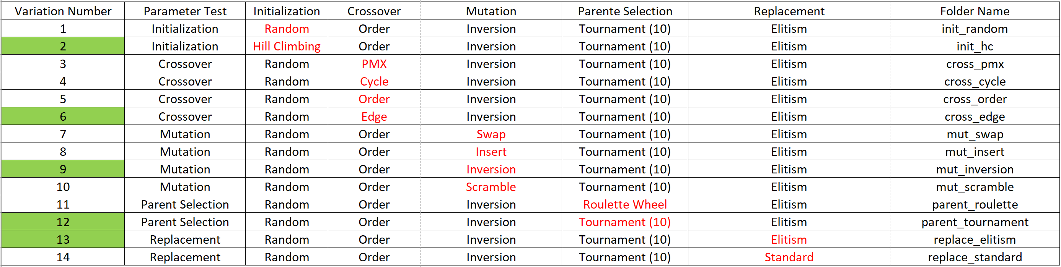
Round 1
Crossover Rate: 0.6
Mutation Rate: 0.6
Tournament Size: 10

Slide 14
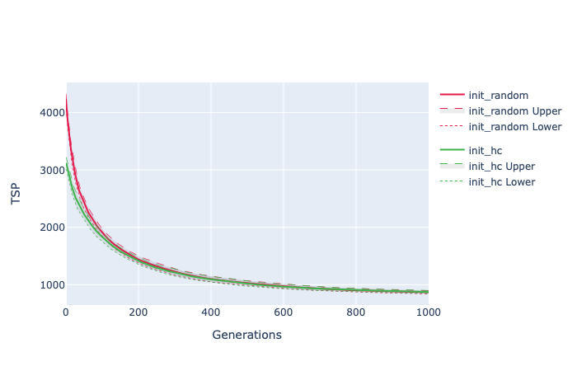
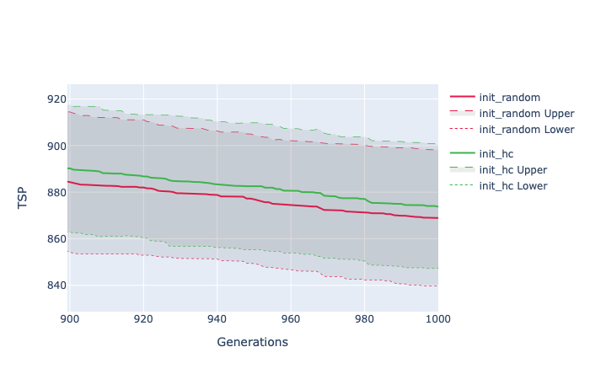
Notes:
Plotting these 5 tests shows the change in the performance of tuning a single parameter. For initialization, the hill-climbing performs better than random but as the number of generations increases the distance between the two is diminishes

Slide 15
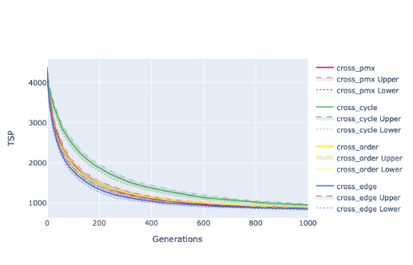
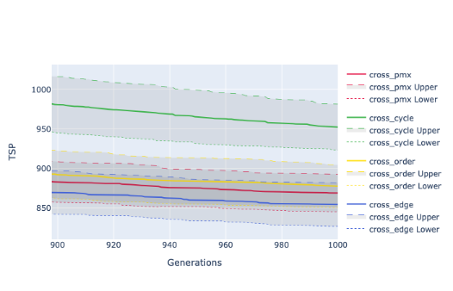
Notes:
Next, the crossover (xover) types are compared with each other. Cycle xover is much worse than the other ones with edge xover being the best. One problem with edge is its runtime, with it performing only marginally better with a significant increase in runtime. This is a key tradeoff as one must determine whether time or performance is more important. If one has enough time for edge then running more generations could also be another possibility

Slide 16
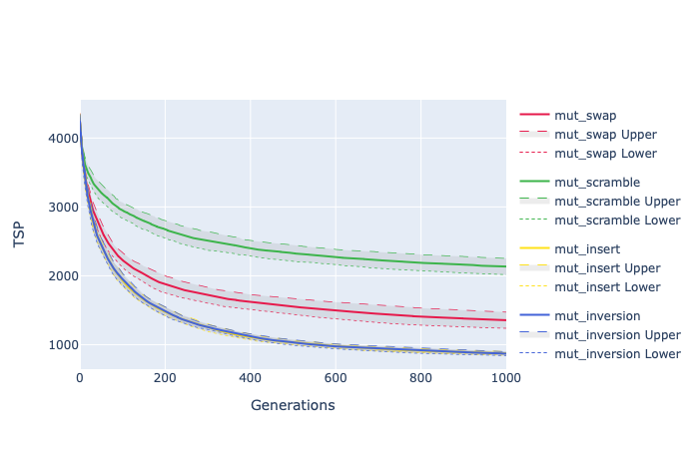
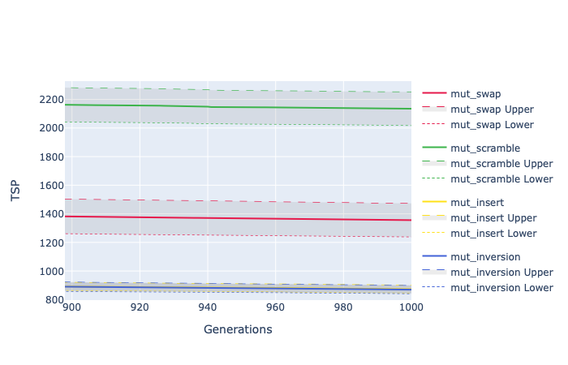
Notes:
The mutations are a good example of how big a difference one parameter can make. The inversion and insert mutations are nearly identical, but swap and scramble are significantly worse. Scramble breaks too many points at once and therefore acts more as a xover than a mutation. Breaking the fewest number of existing connections is the most effective and the results for inversion show this.

Slide 17
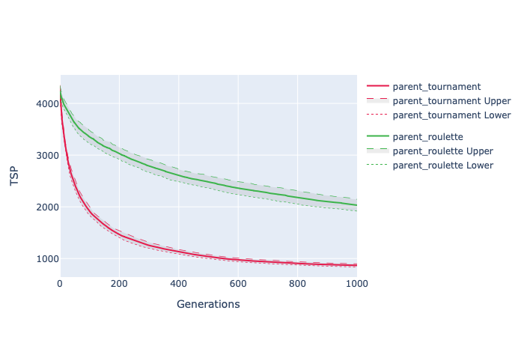
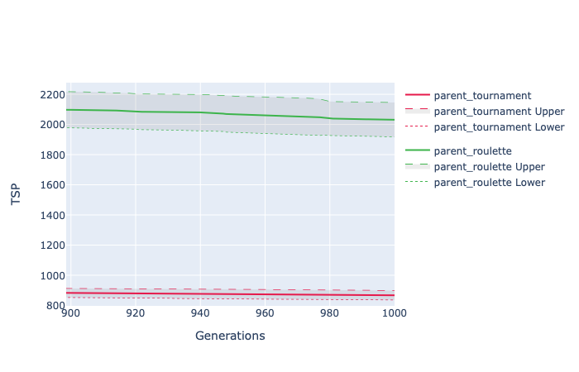
Notes:
The choice of parent selection is quite important as it picks which parents are of high enough quality to xover and mutate. The choice here is quite obvious as tournament converges much quicker than roulette. The range of final value is also minimized which means that any single run will be closer to the average.

Slide 18
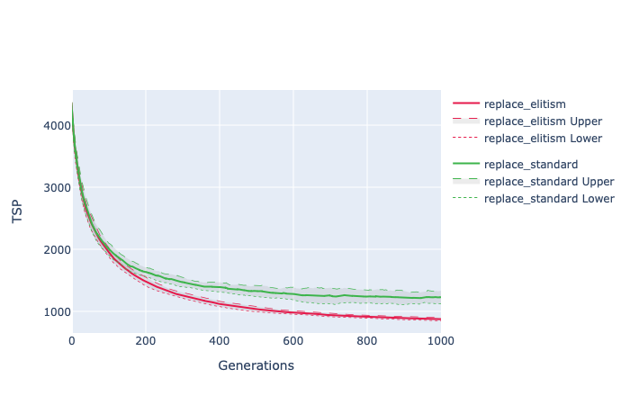
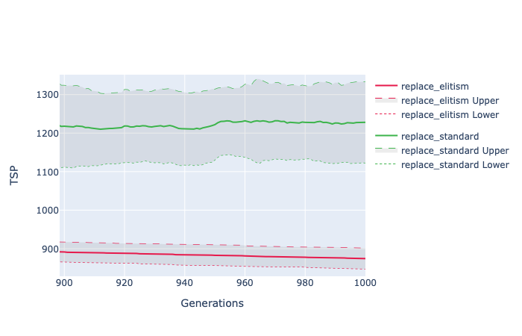
Notes:
The idea of elitism is also important to test as it decides whether or not to keep the best values between runs. As can be seen, not using elitism (standard) not only is worse than elitism but it also can increase (worsen) the fitness over time. The range of values produced by using it is also much larger.

Slide 19
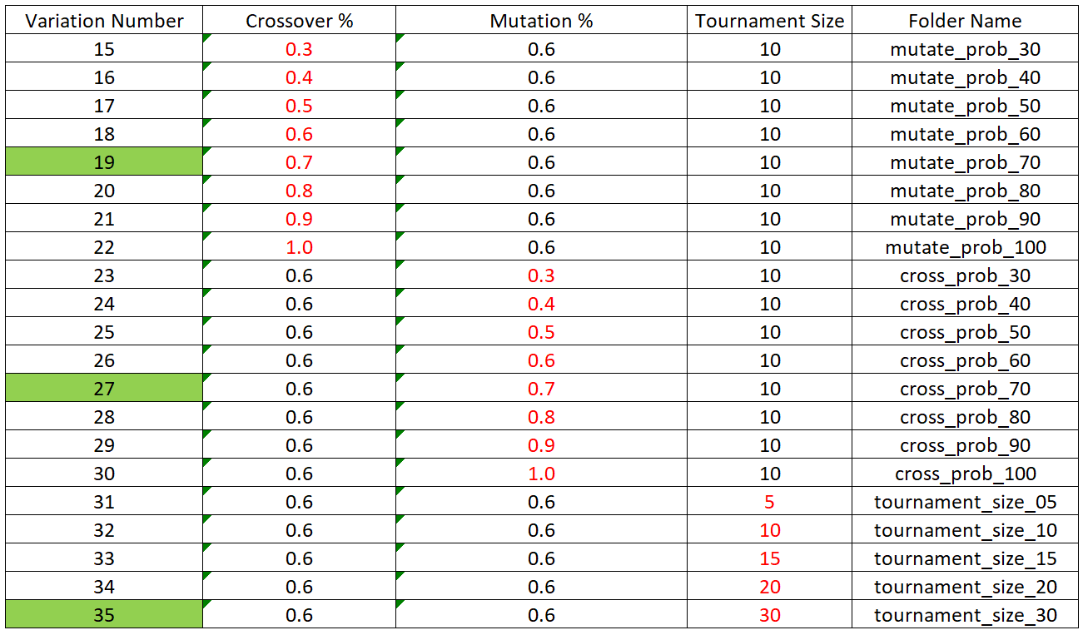
Round 2
Initialization: Hill Climbing
Crossover: Edge
Mutation: Inversion
Parent Selection: Tournament Selection
Replacement: Elitism

Slide 20
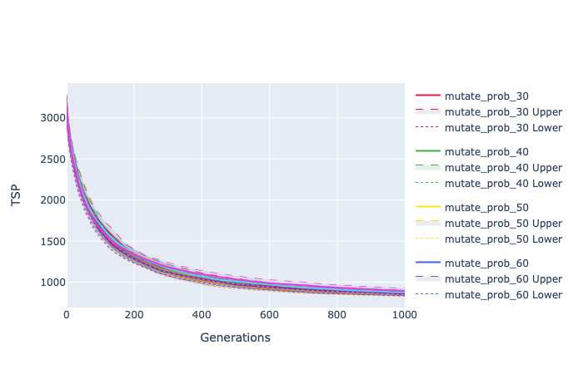
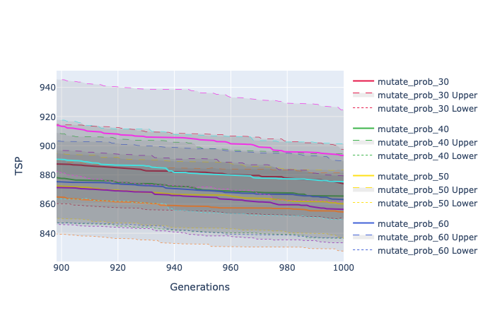
Notes:
Increasing the mutation probability should allow the algorithm to search more of the neighborhood of the population. Therefore, it is interesting that the results show that a 100% probability of mutation is not the best. 70% is the best here with 100% being the worst.

Slide 21

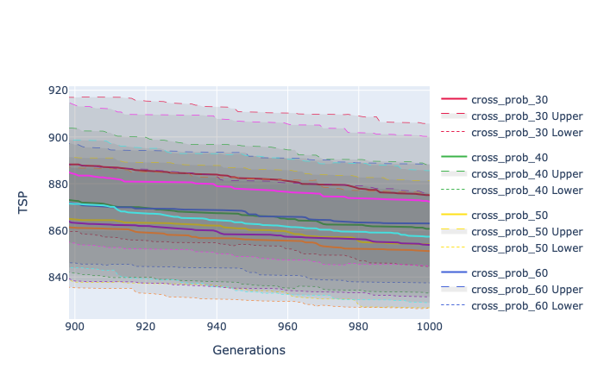
Notes:
The xover probability is interesting to look at as it shows that using too low or too high of value is not good. Too low and not enough of the search space is explored. Too high and the jumps between points in the search space are too large and the chance of finding the global optimum is lowered. The best value is 0.7 (70%) here.

Slide 22
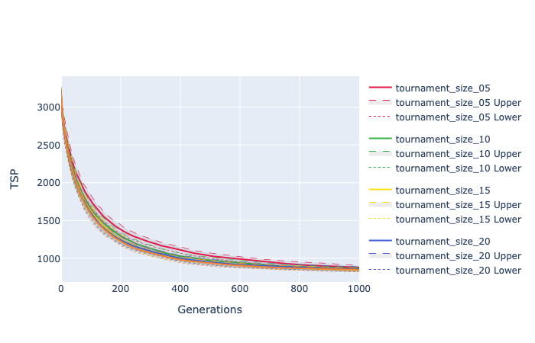
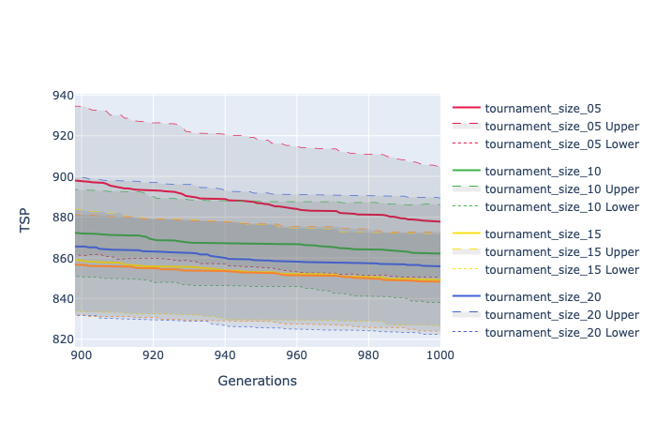
Notes:
The size of the tournaments and their results show that as more participants take part in a “game”, the better the final outcome of the fitness. More participants mean that there is a high chance that the parents are just the best parents as the selection of participants is random. At a tournament size of 30, almost certainly at least one of the participants in each game is the best parent. This means that this acts as a very strict selection, only picking non-best parents a small percentage. The best size is 30 participants.

Slide 23
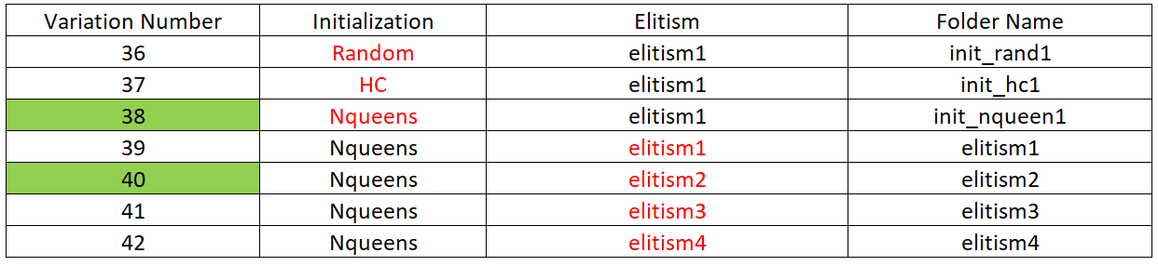
Round 3
Crossover: Edge
Mutation: Inversion
Parent Selection: Tournament Selection
Crossover Rate: 0.7
Mutation Rate: 0.7
Tournament Size: 30

Slide 24
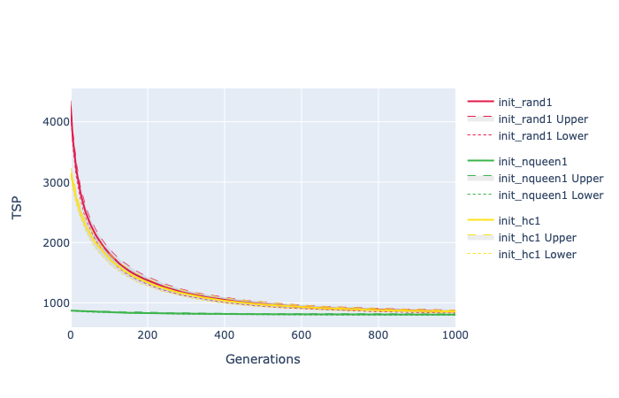
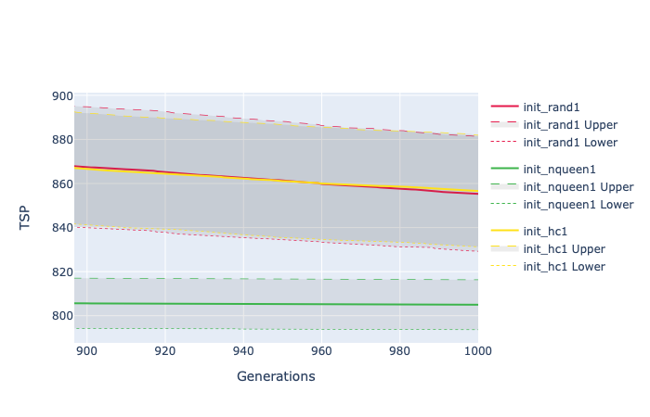
Notes:
From the results, it is very clear that n-queens is much more effective at finding a near-optimal solution from the beginning. With better initial values the algorithm is able to find better final results as well. The zoomed-in graph also shows that at 1000 generations, the hill-climbing algorithm is actually slightly worse than the random initialization

Slide 25
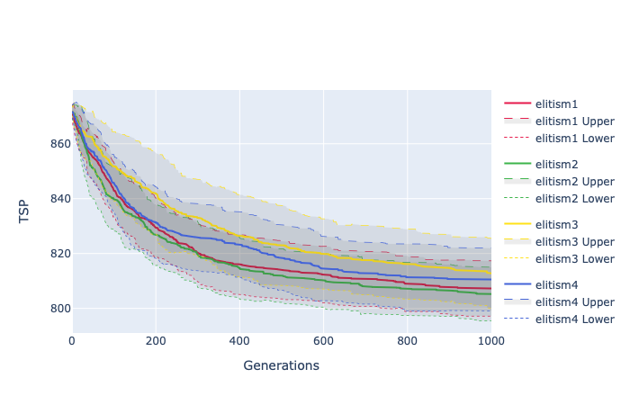
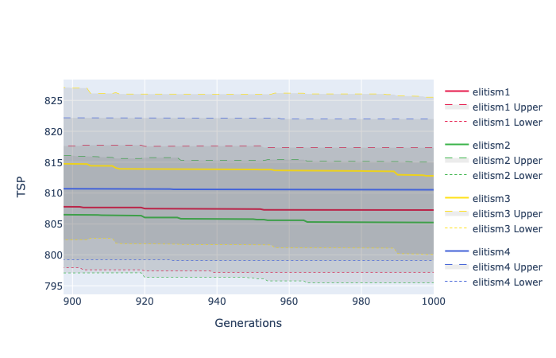
Notes:
Testing different elitisms is interesting as it gives more insights on how many of the parents should be kept as offspring. More quality parents mean a better population but at the same time a population that is less diverse and therefore more likely to become stuck in a local optimum. From the results, elitism 1 and 2 are quite similar to elitism 2 a few fitness points better

Slide 26
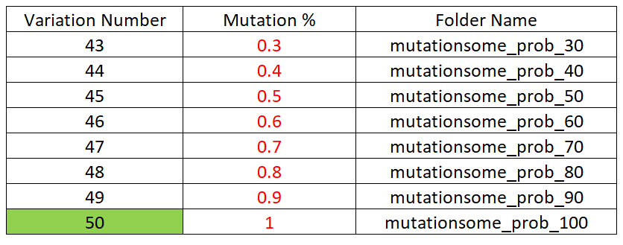
Round 4
Crossover: Edge
Mutation: Inversion
Parent Selection: Tournament Selection
Replacement: Elitism 2
Crossover Rate: 0.7
Tournament Size: 30
Initialization: n-queens

Slide 27
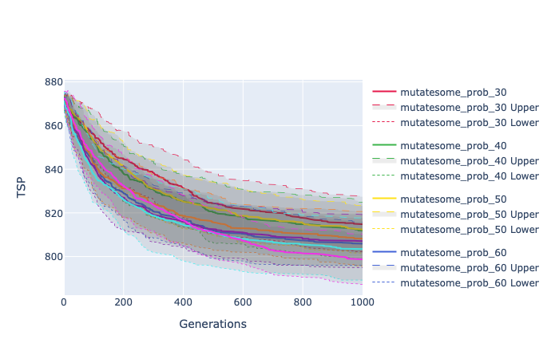
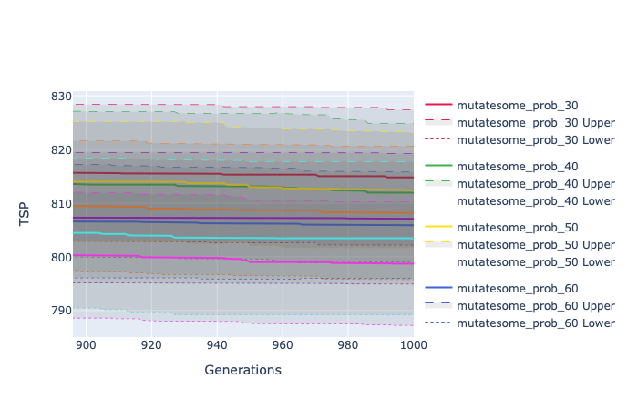

Slide 28
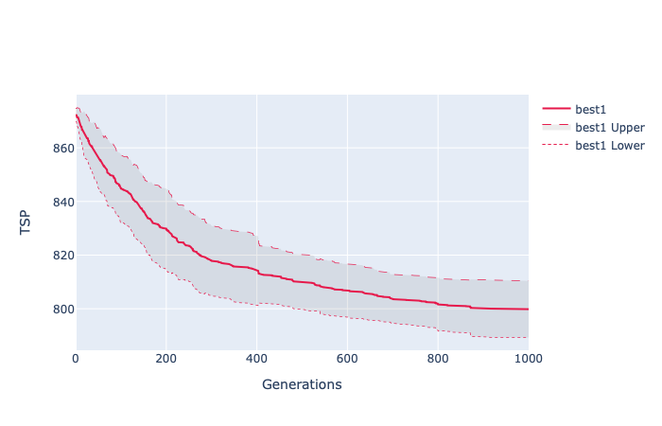
Best Results
Crossover: Edge
Mutation: Inversion
Parent Selection: Tournament Selection
Replacement: Elitism 2
Crossover Rate: 0.7
Mutation Rate: 1.0
Tournament Size: 30
Initialization: n-queens
The lower bound for this is: 778

Slide 29

Portfolio Investment Problem (PIP)

Slide 30
Crossovers
singlepoint_crossover_pip: the same as the single point crossover but normalizes the portfolio after performing the operation.
two_point_crossover_pip: the same as the two-point crossover, also normalizing the portfolio.
pipArithmeticCrossover: the offsprings are arithmetic combinations of the parents. Despite the possibility of invalid sizes and the need of normalizing the resulting portfolios, this approach was implemented to better explore the portfolios with higher number of assets.
pipHeuristicCrossover: the first offspring is the parent with the best fitness and the second offspring is the arithmetic combination with the best fitness.

Slide 31
Admissibility
The number of assets is smaller than the maximum portfolio size;
The sum of weights is equal to 100%;
The Sharpe ratio is higher than 1.0.

Slide 32
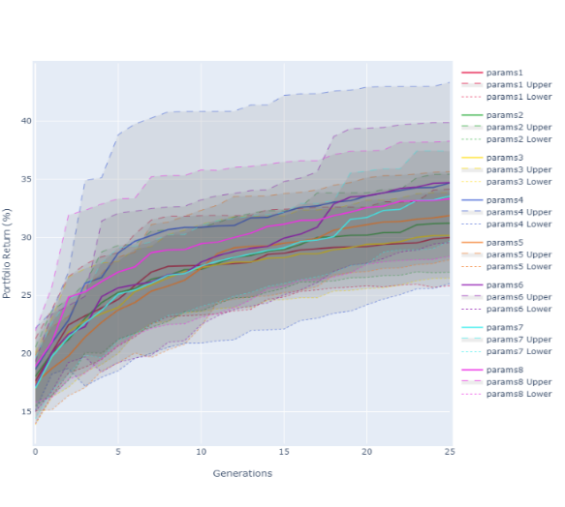
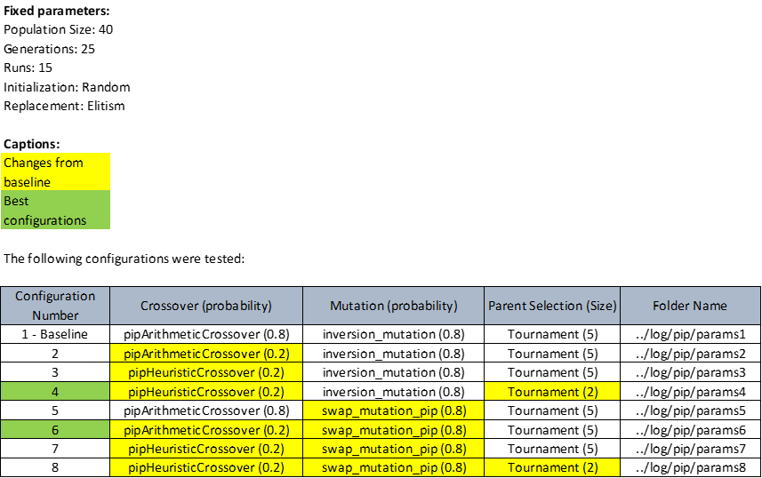
Round 1

Slide 33
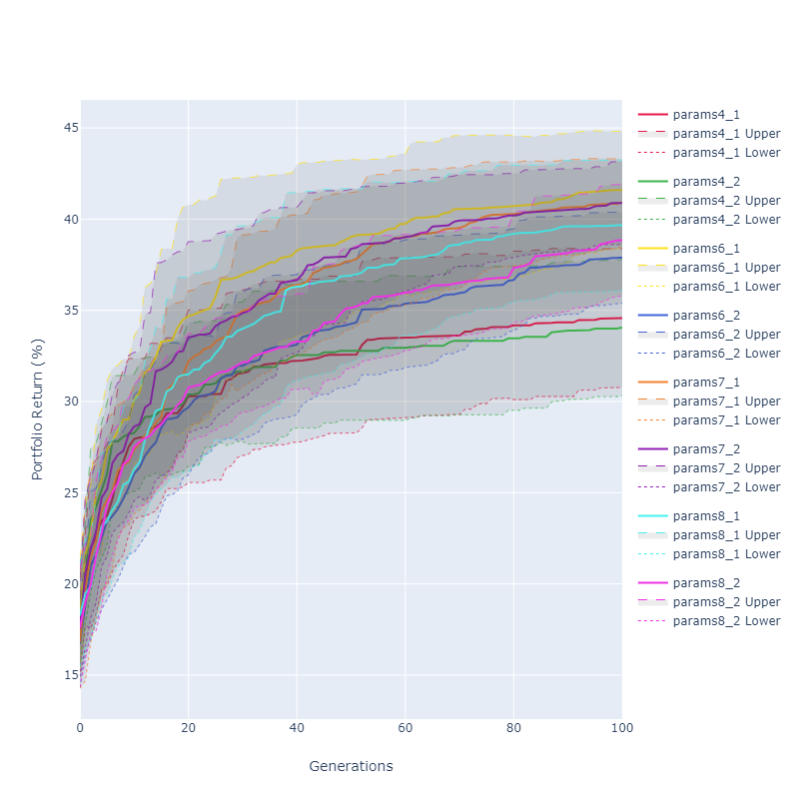
Round 2

Slide 34
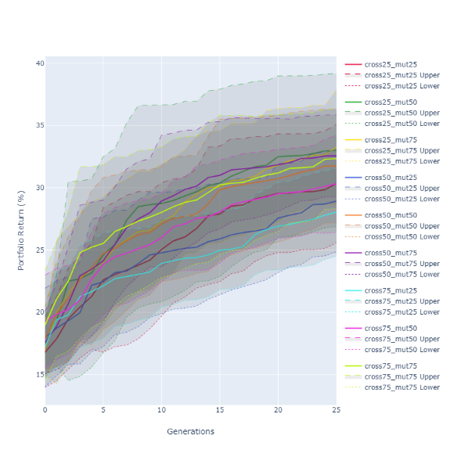
Round 3

Slide 35
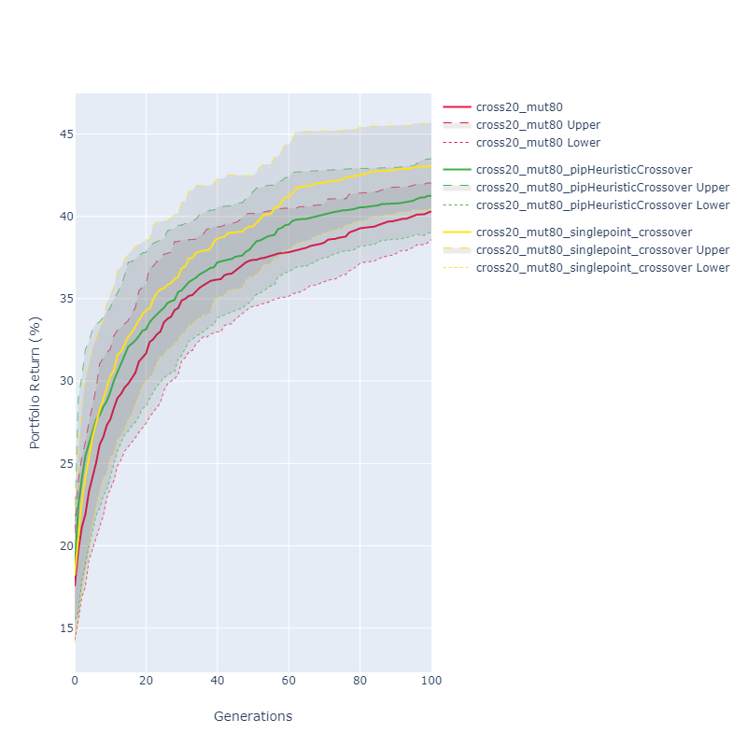
Round 4

Slide 36
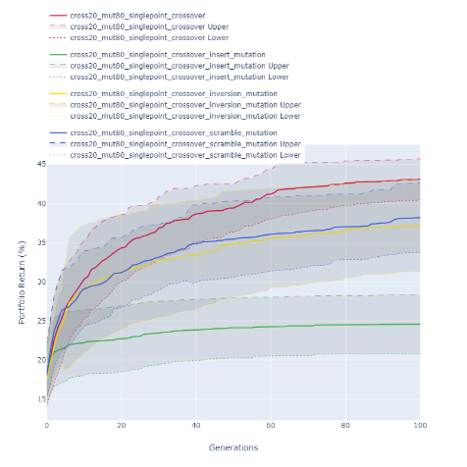
Round 5

Slide 37
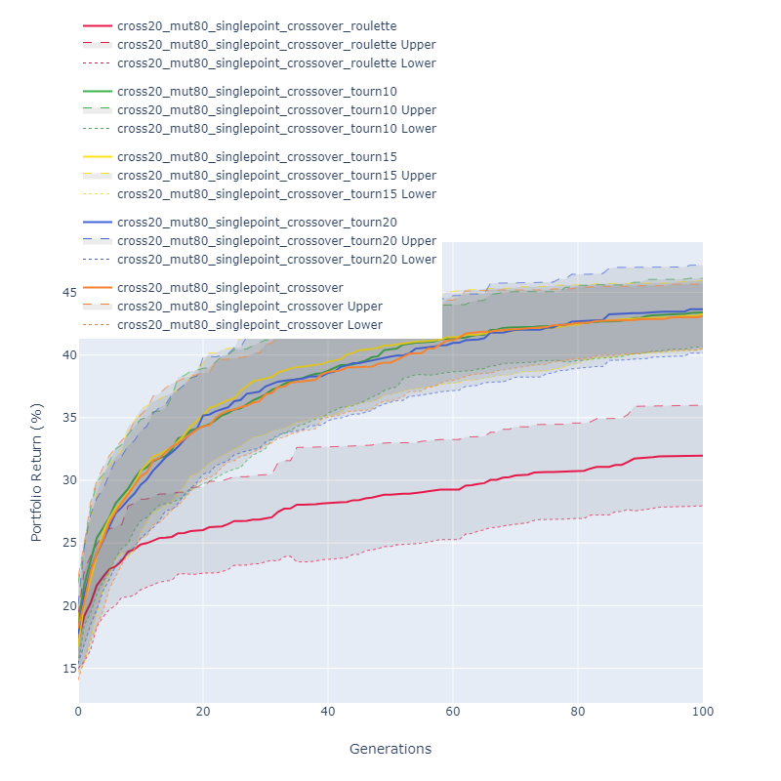
Round 6

Slide 38
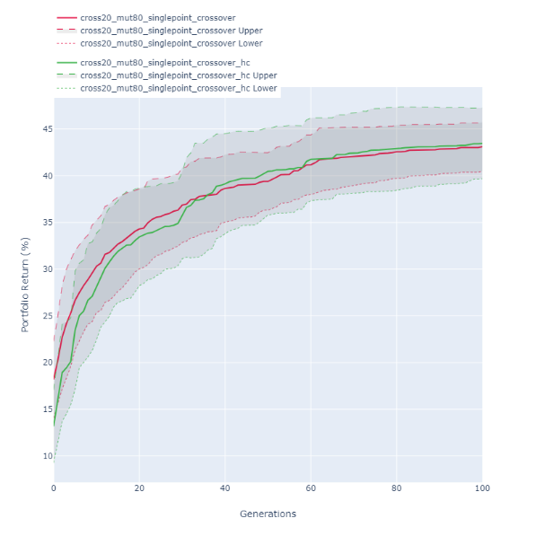
Round 7

Slide 39
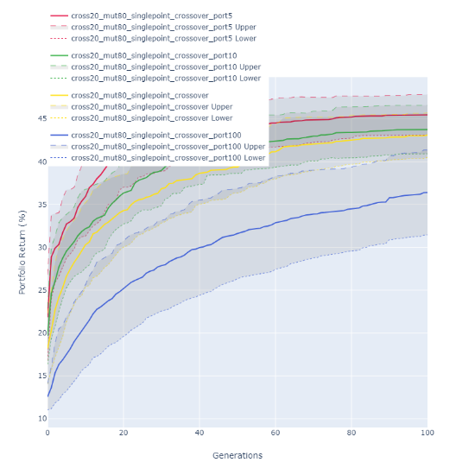
Round 8

Slide 40
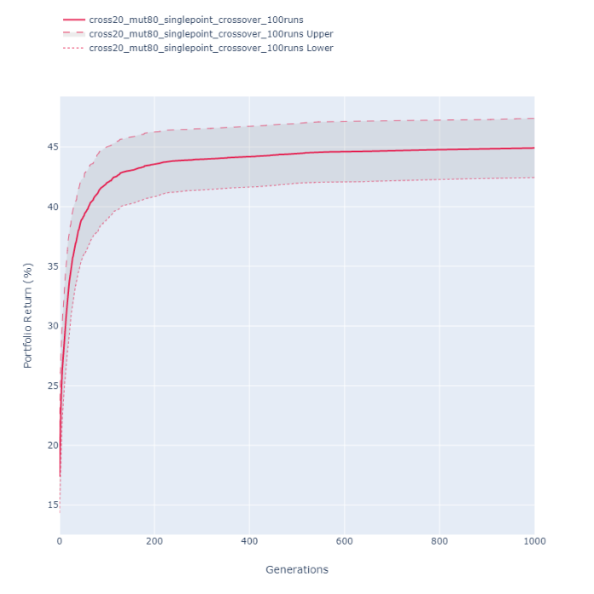
Round 9

Slide 41
Best Results
Share (%) | symbol | Name | exp_return_3m (%) | std_deviation (%)
89 | ALGN | Align Technology | 54.02 | 46.40777565
1 | BAC | Bank of America Corp | 22.34 | 9.457633208
1 | COTY | Coty Inc | 35.64 | 30.68877112
1 | HPE | Hewlett Packard Enterprise Comp | 32.3 | 8.769131347
1 | STT | State Street Corp | 44.55 | 29.85719963
6 | TGT | Target Corp | 47.82 | 40.67472137
1 | TIF | Tiffany & Company | 49.93 | 24.09284566
The best fitness (return) obtained in this final run was 52.79%/yr, with the following portfolio:
The best fitness obtained in all runs was 54.02%/yr (round 5, with inversion mutation), with a one-asset-only portfolio concentrated in ALGN. Since this is the asset with the highest expected return in SP500 and its standard deviation returns a Sharpe Ratio higher than 1, being a feasible solution, it’s possible to say that this is the global optimum, despite not being applicable to real life as a risk control strategy.

Slide 42
Best Results
A possible way to force a more diversified (and less risky) portfolio would be to increase the Sharpe Ratio requirement. In a single test with a minimum of 2 as Sharpe Ratio, the following 11-asset portfolio was achieved with 47.17%/yr return:
Share (%) | symbol | Name | exp_return_3m (%) | std_deviation (%)
46 | ALGN | Align Technology | 54.02 | 46.40777565
1 | AMD | Adv Micro Devices | 33.4 | 27.36014811
1 | CE | Celanese Corp | 11.19 | 8.481856032
1 | COTY | Coty Inc | 35.64 | 30.68877112
1 | GE | General Electric Company | 35.92 | 16.31810614
5 | HPE | Hewlett Packard Enterprise Comp | 32.3 | 8.769131347
17 | PVH | Phillips-Van Heusen Corp | 36.15 | 13.20410045
4 | QRVO | Qorvo Inc | 39.46 | 20.47011228
1 | STT | State Street Corp | 44.55 | 29.85719963
5 | TGT | Target Corp | 47.82 | 40.67472137
18 | TIF | Tiffany & Company | 49.93 | 24.09284566

